Slide 1
The Future Market Environment of Mobility
Key Note Presentation
Fleet Mobility EXEX Estonia
10th January 2016

Slide 2

Today’s Agenda
Agenda
Introduction
Introduction: Transformational Shifts Reshaping the Future of Mobility
Transformational Shifts Reshaping the Future of Mobility
Conclusions
Contact Us
Source: Frost & Sullivan

Slide 3
Global Light Vehicle Sales by Region in 2016—A Snapshot
US to drive global sales reaching 17.5 ml. Chinese sales to remain flat in 2016
2-3% YoY growth (2015–16)
~ 91 Million
~ 89 Million
2016
16%
Other4.0
WE 16%
Indonesia 0.7
5%
South Korea 1.7
5%
Latin America 5%
India 3.3
Others 5%
Japan 4.9
22%
NA 22%
Canada 1.8
2%
The Middle East 1%
Mexico 1.4
4%
Eastern Europe 4%
Canada 1.8
China 26
Turkey 0.8
Brazil 3.9
Others 3.2
Russia 2.8
USA 18.6
Argentina
0.6
UK 2.8
Spain 1.3
Units (Million)
Asia 45%
Others 1
Poland 0.4
Italy 1.8
46%
Other 1.1
France 2.3
Egypt 0.3
Brazil 3.2
Germany 3.5
Africa 1%
Russia 1.1
Iran 1.2
1%
Source: LMC Automotive, Frost & Sullivan

Slide 4
Transformational Shifts Reshaping the Future of Mobility

Slide 5

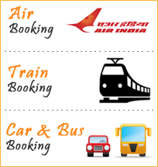
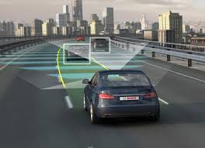
Top Transformational Shifts Expected to Shape the Future of Mobility
Connected and Automated Mobility
Mobility Integration
Convergence in Corporate Mobility
Automated Driving
Notes:
Based on audience, relate these to the fleet and leasing industry and how they can be opportunities/risks

Slide 6
Top Transformational Shifts Expected to Shape the Future of Mobility
- Connected and Automated Mobility
Connected and Automated Mobility
Mobility Integration
Convergence in Corporate Mobility
Automated Driving
Notes:
Based on audience, relate these to the fleet and leasing industry and how they can be opportunities/risks

Slide 7



Future Connected Living Ecosystem
The connected life contains three important environments, all with high expectations for “everywhere”
Connected Living Total Market: $730 Billion in 2020
Connected Home – 31%
Connected Work –15%
Connected City – 54%
Home Automation
Home Energy
Home Health
Home Entertainment
Mobility - Mobile email, Unified Communication
Mobile Working
Enterprise Social Networking
eGovernance
eCitizens
Personal and Freight Mobility
E-learning
Mobile banking
Source: Frost & Sullivan
Notes:
Spend some time ref the connected City – the presentations are at small cities that can 1. learn from others, 2. lead the innovation as they have less legacy systems
Everywhere – i.e. access to your files and data everywhere – e.g. music library

Slide 8
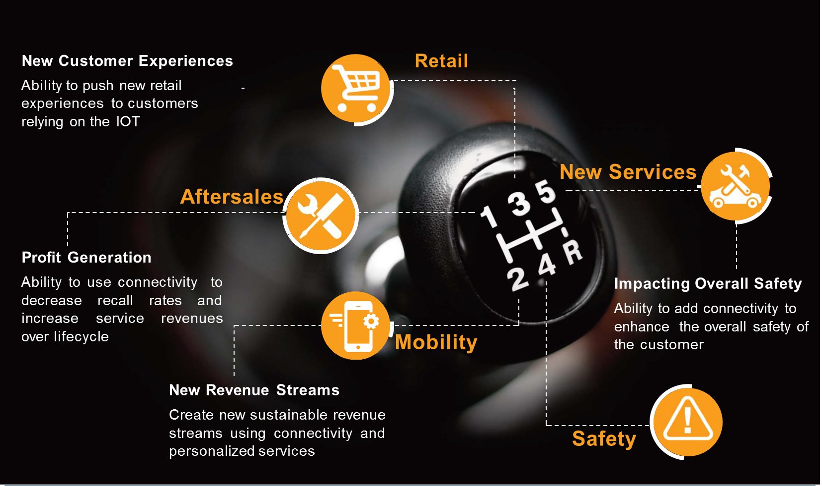
Connected Car Programs at OEMs are going through a Major Strategy Change

Slide 9
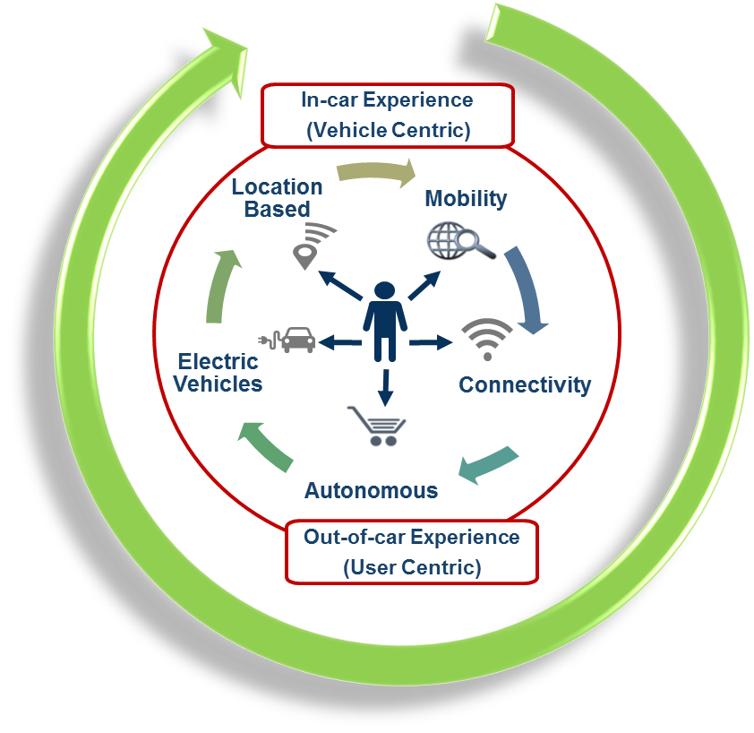





Understanding the typical automotive customer journey is crucial to developing products & services around the vehicle
Pre-Purchase
(OEM Centric)
Car as a Service
(CaaS)
Re - purchase
(OEM Centric)
1) Attract
2) Entertain
3) Engage
4) Transact
1) Entertain
2) Engage
3) Reward

Slide 10
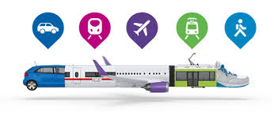
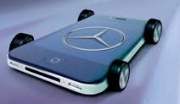
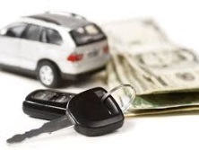
Evolution of OEMs Mobility Services
Car companies are evolving from the business of manufacturing & selling just cars, to providing related services, and multi-modal mobility solutions to target new customers, and future proof their business
Car Independent
Integrated Mobility: Journey Planning, Booking & Payment
City Planners & Lifestyle
Energy creation & storage
Car Services
Carsharing
Parking & Charging
Ride-sharing
Taxi & Limousine
Automated Driving
Evolution & Expansion of OEM Services
Car Ownership
Finance
Maintenance
Connected Services

Slide 11
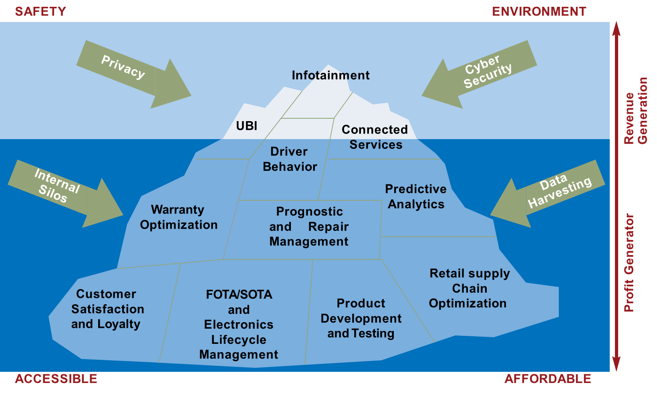
Potential for explosive growth
Ultimately connected car programs need to be profit generators and customer loyalty improvement programs which have large potential for growth

Slide 12
Top Transformational Shifts Expected to Shape the Future of Mobility
- Mobility Integration
Connected and Automated Mobility
Mobility Integration
Convergence in Corporate Mobility
Automated Driving
Notes:
Based on audience, relate these to the fleet and leasing industry and how they can be opportunities/risks

Slide 13






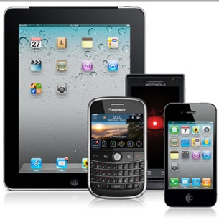








Tech Enabled, Door-to-Door, Multi-Modal Travel Bringing Convenience, Time & Cost Savings
Dynamic
Parking
Car Sharing and Pooling
Car Rental & Leasing
Demand
Responsive
Transport
(Taxi, BRT)
Intercity Public Transport
Intracity Public Transport
Car Rental
Connected Living
(Including Car)
PHYD
Insurance
Micro-mobility Solutions
Trains/Flights Integration
Energy Management
Apps, Journey Planning, Big Data
Concierge Services
Source: Frost & Sullivan

Slide 14
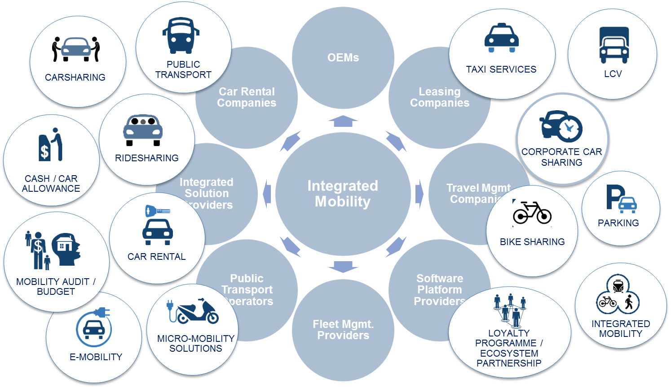
Mobility Landscape – Many Actors, New Partnerships, New Models
Across Consumer and Business environments customers are demanding intuitive services; many actors investing significantly to deliver the ‘killer’ proposition & seamless user experience

Slide 15
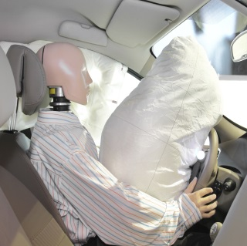
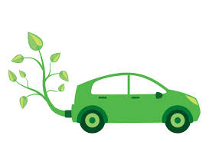


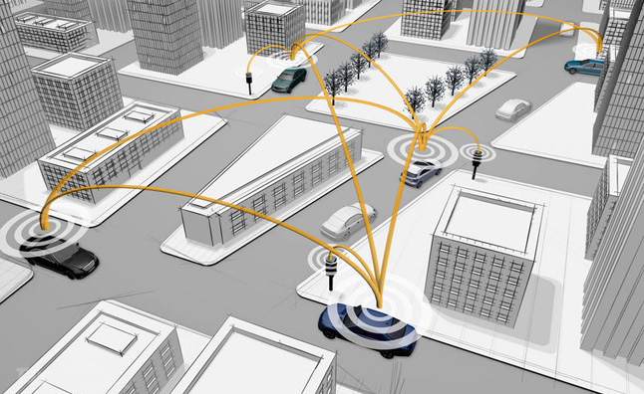
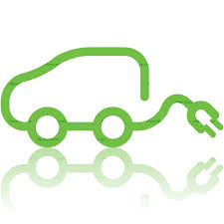
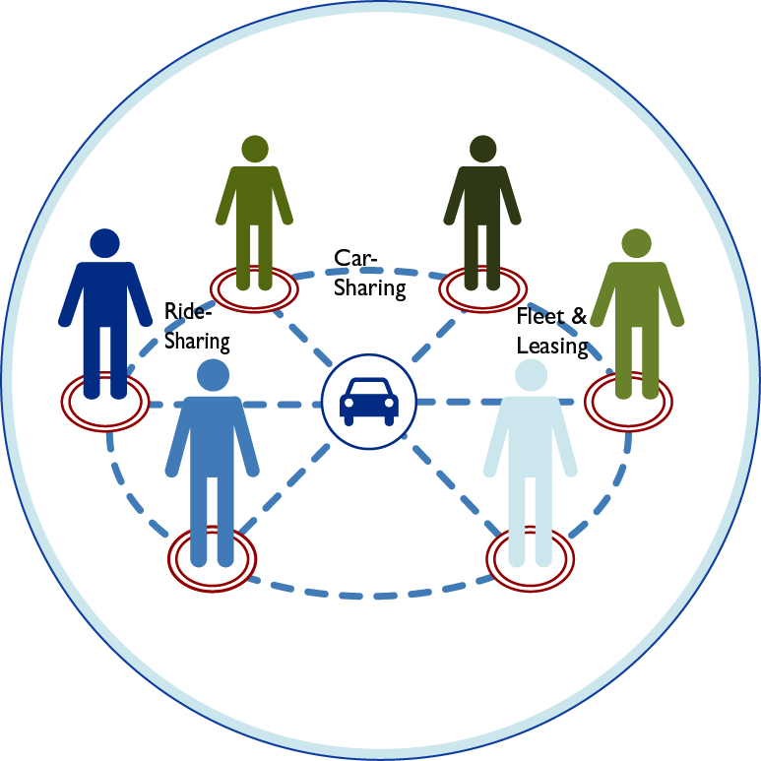
Intelligent Mobility—An Emerging Concept that Revolutionizes Mobility
Intelligent mobility aims to create vehicles that promote a eco-driving experience, insulated from crash fatalities and tuned to combat congestion.
Current 2015
Siloistic Approach
Car Sharing
Ride Sharing
Safety
Environment
Transportation
Future 2035
Integrated Approach
Connected & Automated Mobility
Smart & Eco-driving
New Mobility Models
Source: Frost & Sullivan
Notes:
http://www.clipartbest.co/ele
http://www.quora.com/What-have-you-found-to-be-the-best-way-to-promote-your-blog-contentctrician-tape-clipart/
Automotive council UK proposes a unified approach to bridge this disconnect called intelligent mobility.
It is an integrated approach towards achieving the global transportation industry’s 3 key goals of safer, cleaner, and leaner mobility by leveraging vehicle automation, cooperative driving, new mobility models, alternative propulsion, and traffic flow optimization.

Slide 16


Intelligent Mobility—A Multi-faceted Sustainable Solution
Several facets of today’s mobility solutions will face disruption and evolve to fit tomorrow’s intelligent mobility ecosystem, resulting in improved benefits and responsibilities for consumers.
Mobility
Innovative and diverse mobility solutions that cater to a wide range of consumers’ mobility needs will exist cohesively, providing cost-effective and time-saving travel options for commuters.
i
Savings potential
Smart access
Mobility planning apps
Integrated fare management
Framework
Current infrastructural framework and enablers need to be upgraded or purpose built to a higher plane of intelligence to serve the upcoming needs of intelligent mobility.
Fleet and leasing
Smart parking
Rapid shuttles
Real-time traffic management
Road trains
Shared mobility
Self learning car
Dedicated lane
Source: Frost & Sullivan
Notes:
Dedicated lane: inductive charging, self driving lane

Slide 17
Impacts of Intelligent Mobility
As a unified approach, intelligent mobility reduces traffic congestion by a fifth, carbon emission by a tenth, and optimizes travel speed up to 60%, depending on infrastructural intelligence.
Safety
Modes
Emission
Incident management >> 15–33% reduction in crash prevention
Enhanced collision avoidance >> 10% reduction in crash prevention
Optimized ride/car sharing modalities >> Reduction in annual costs of $5.6 billion
Group rapid transits and personal rapid transits >> Reduce travel time by 25%
Increase average travel speed >> 10–15% reduction in CO₂ emission
Traffic signal light optimization >> Reduce stops by 40%
Phase I
Phase II
Traffic flow optimization >> Reduce congestion by 12% to 30%
Optimize travel speeds >> Increase road speeds from 8–60%
Efficient driving modes >> Reduce fuel consumption by 10%
Source: Frost & Sullivan
Notes:
A number of ITS applications contribute to enhancing the operational performance of transportation
networks: traffic signal light optimization can improve traffic flow significantly by reducing stops by
40%, fuel consumption by 10%, vehicle emissions by 22%, and travel time by 25%; ramp metering
can increase vehicle throughput (the number of cars that pass through a road lane) from 8 – 22% and ◄increase road speeds from 8 – 60%. Additionally, up to 30% of highway congestion occurs at toll
stops, deploying electronic toll collection systems have been found to reduce vehicle emissions by 16
– 60% (USDOT, 2008). Assessing the impact of ITS including ramp metering, incident management,
traffic signal coordination, and arterial access management, the US government found a reduction in
urban delays of 9% (336 million hours) led to a further reduction in annual costs of USD 5.6 billion due
to reduced fuel consumption and hours of delay (GAO, 2005). 8:19:12 PM

Slide 18







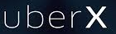













Growth of Ride Sharing Business Models
Public Transport
Higher Price per KM
“Taxi” & Limousine
Services
Planned –
Long
Distance
Instant –
Short
Distance
“On Demand”
Carpooling
Corporate
Carpooling?
“Transportation
Network
Companies”
“Fixed” Carpooling
Lower Price per KM
Source: Frost & Sullivan
Notes:
In this slide we look at the ridesharing market. There are 3 interesting business models for ridesharing –
The Fixed models where ther is a: Prior arrangement of trips, advertising/requesting empty space in a vehicle doing a common route
Dynamic: Real time advertising/requesting empty space in a vehicle doing a common route
Transportation Network Companies: Real time request for journeys, whereby driver specifically reacts to that request with the intention of taking payment for the service.
There are already >15m Rideshare members in Europe, the majority 18-25 year olds but the appeal is increasing; Blablacar boast 25% of French 18-25 year olds as members – critical mass in Gen Y customers
In the future Cars likely to be enabled with rideshare capability for real time booking/space linked to navigation and
Opportunity exists for platforms to integrate discretional and regular trips as one business model
Disruption in the market. Flinc at businesses; SAP TwoGo. If that gets used by an employer then why not link to other usership products? Rental? Leasing? Could they be a challenger in the future?

Slide 19


New Business Models - Growth of Car Sharing
Over 543,000 vehicles to be shared in Europe by 2020
Carsharing
Carpooling
2014
Traditional | 49,368 | 2.5 million
P2P | 81,380 | 1 million
Corporate | 2,896 | 250 companies
2020
Traditional | 236,145 | 14.9 million
P2P | 222,210 | 3.3 million
Corporate | 84,649 | 4,000 companies
Source: Frost & Sullivan

Slide 20
Top Transformational Shifts Expected to Shape the Future of Mobility
- Convergence in Corporate Mobility
Connected and Automated Mobility
Mobility Integration
Convergence in Corporate Mobility
Automated Driving
Notes:
Based on audience, relate these to the fleet and leasing industry and how they can be opportunities/risks

Slide 21
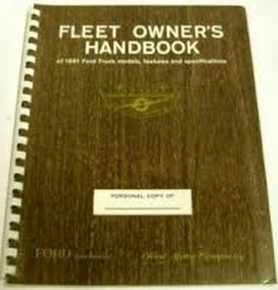
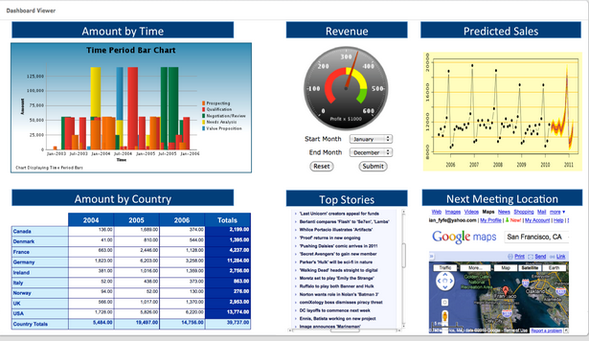

Future of Corporate Mobility – From TCO to TCM
Total Cost of OWNERSHIP
  Running Core Fleet & Keeping Company
  Drivers Informed
FLEET MANAGEMTN
TRAVEL MANAGEMENT
Total Cost of USERSHIP
  Managing Overall Fleet & Educating All
  Company Drivers
EXPENSE MANAGEMENT
Total Cost of MOBILITY
  Delivering Integrated Services &
  Empowering
  All Employees
MOBILITY MANAGEMENT
Source: Frost & Sullivan
Notes:
The boundaries between Fleet, Travel and Expense Management are blurring
Customized text: First explain how we will meet the client’s specific, articulated need. For example: if the client has requested assistance in planning a market entry, list which steps we will complete across the engagement (e.g., demographic analysis, competitive intelligence collection, regulatory evaluation), detail on what we will accomplish within each step, and what deliverables we will provide. You can then transition into the text listed below, which sets you up to share the graphic on the following page, which illustrates the full spectrum of Frost & Sullivan services across this growth process.
Generic text: Frost & Sullivan offers a wide variety of resources that can help clients successfully execute geographic expansion. We provide strategic support to help companies gain a deep understanding of their expansion priorities, current markets, potential new markets, key players, potential partners or distributors, and entry strategy. The figure on the following page outlines these capabilities in more detail and positions the full spectrum of our services within the context across the phases of Geographic Expansion.

Slide 22
Interest Towards Mobility Allowance
54% of the sample expressed interested in a move to a “Mobility Allowance”
As expected Belgium (62%) and Netherlands (59%) expressed greatest interest.
16% Very interested In mobility allowance solution | 38% Somewhat Interested in mobility allowance solution | 17% Neither/Nor | 16% Somewhat not interested in mobility solution | 10% Not interested at all in mobility allowance solution
Netherlands
(N=41)
UK
(N=76)
Germany
(N=74)
France
(N=65)
Belgium
(N=54)
Q10. Interest in mobility allowance solution? Base: those who have corporate car or cash allowance N=310

Slide 23
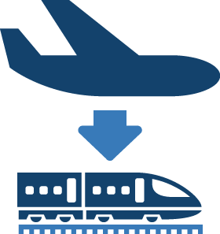


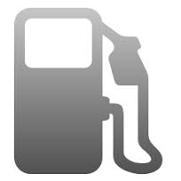





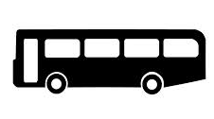




Mobility Integration Services
Services typically integrated by a Travel Management Company are the most preferred.
Payment options feature prominently; an any device strategy is integral to Future Mobility
Most Preferred Services (top 5 ranking) - Europe
55%
53%
44%
41%
38%
29%
23%
23%
Hotel/Flight Booking
Car Rental
Train ticketing
‘Fuel’ Payment*
Trip Planner
Parking Payment
Taxi Payment
Taxi Booking
22%
22%
22%
17%
16%
11%
8%
Car Sharing ⁺ Membership
Airport Lounge
Tube/Bus Ticketing
Hourly Office Rental
Car Pooling
Cycle
Rental
Navigation Service
Q31. Most preferred services in an integrated solution n=465
Preferences were selected by respondents from a pre-defined list of services as opposed to a free format / free choice approach
* Covering payment of traditional fuel, energy and other services available from fuelling / charging stations e.g. cleaning / valeting
+ On-demand access to vehicles through services such as DriveNow, Car2Go, Zipcar, etc.

Slide 24
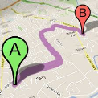






Mobility Integration Services in Mobile Application
Journey Planning is the most desirable service so must be a priority component of an Integrated Mobility service
Mobility Integration Service in Mobile Application - Europe
49%
43%
41%
40%
39%
Journey Planning
Boarding Pass
Online Check-in
Mobile Payment
Expenses Claiming
37%
32%
23%
15%
Navigation Service
Real Time Information
Mobility Booking
Mobility Reporting
Q33. Interest on mobile applications for the new mobility solution. Base: Total n=465
Preferences were selected by respondents from a pre-defined list of services as opposed to a free format / free choice approach

Slide 25
Mobility Integration Future Service Providers
Leasing companies considered by decision-makers to be best placed to deliver Integrated Mobility services albeit picture is mixed confirming the fragmented nature of the market
Best Player to Provide New Solution-Europe
Best Player to Provide New Solution-by country
Don’t Know
 | UK (n=106) | FR (n=98) | DE (n=97) | NL (n=78) | BE (n=86)
Car leasing companies | 23% | 18% | 23% | 38% | 23%
Car rental companies | 12% | 21% | 15% | 15% | 15%
Corporate Travel agencies | 21% | 20% | 15% | 1% | 14%
Car OEMs | 9% | 12% | 25% | 12% | 14%
Mobility specialist provider | 14% | 14% | 9% | 13% | 15%
Technology provider | 8% | 3% | 2% | 3% | 3%
Car leasing companies
Technology Provider
Mobility specialist
Car OEMs
Car rental companies
Corporate travel agencies
Q32 Best player to deliver integrated mobility solution service. Base : total n=465.
Top results highlighted in red

Slide 26
Top Transformational Shifts Expected to Shape the Future of Mobility
- Automated Driving
Connected and Automated Mobility
Mobility Integration
Convergence in Corporate Mobility
Automated Driving
Notes:
Based on audience, relate these to the fleet and leasing industry and how they can be opportunities/risks

Slide 27
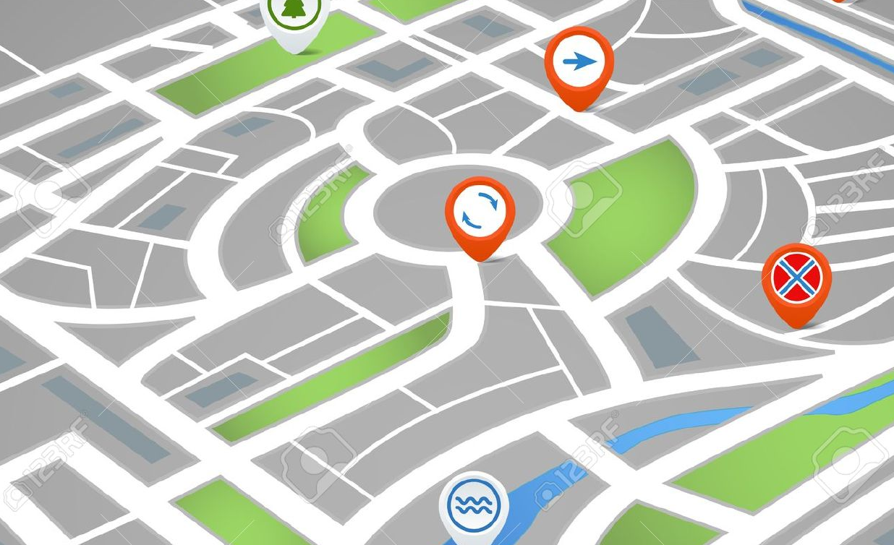
Autonomous Cars New Business Models
Four key areas impacted by Fully-Autonomous Mobility
Fully-Autonomous
Mobility Opportunities
Vehicle on-Demand
First &
Last mile Commuting
Mobility as
a Utility
Peer-to-Peer Sharing
Source: Frost & Sullivan
Notes:
Vehicle-on-demand & Peer-to-Peer Car Sharing: Autonomous vehicles will likely reduce vehicle ownership and parking costs by allowing shared, self-driving taxies to replace personal vehicles Research estimates that, by allowing household vehicles to serve multiple residents, for example, after taking a commuter to work, transporting other household member for errands and social activities, could recue vehicle ownership up to 43%, from 2.1 to 1.2 average vehicles per household, but increase travel per vehicle by up to 75%, from 11,661 to 20,406 annual miles per vehicle.
These impacts and benefits are difficult to predict. Many motorists prefer to own personal vehicles for identity (to display their style and success) and convenience (because they often leave equipment in vehicles or carry dirty loads). Shared autonomous vehicle cost profiles are likely to range between car sharing ($0.60- $1.00 per vehicle-mile, including ownership, operation and administrative costs) and human-operated taxis ($2.00-3.00 per vehicle-mile including ownership, operation, administration and labor costs).
Autonomous taxis are likely to incur these additional costs:
• Additional vehicle travel to trip origins. This may be modest in dense urban areas where such taxis are widely distributed, but is likely to add 10-20% to total vehicle travel in lower-density suburban and rural areas, or for specialized vehicles such as vans and trucks.
• Cleaning and vandalism. Taxis and public transit vehicles require frequent cleaning when passengers litter, smoke, spill food and drinks, spit or bring pets, and repairs when vehicles are vandalized. To minimize these risks self-driving taxis will need hardened surfaces, durable fabrics, minimal moving parts, electronic surveillance, and aggressive enforcement. Assuming that vehicles make 200 weekly trips, 5-15% of passengers leave messes with $10-30 average cleanup costs, and 1-4% vandalize vehicles with $50-100 average repair costs, these costs would average between $200 and $1,700 per vehicle-week.
• Reduced services. Drivers often help passengers (particularly those with disabilities) in and out of taxies, carry luggage, ensure passengers safely reach destinations, and offer guidance to visitors.
• Reduced comfort and privacy. Vehicles designed to minimize cleaning and vandalism risks will probably have less comfort (no leather upholstery or carpeted floors), fewer accessories (limited sound systems), and less reliability (since vehicles will frequently need cleaning and repairs) than personal vehicles. Passengers will need to accept that their activities will be recorded. Personal automobiles typically cost about $4,000 annually in fixed expenses plus 20¢ per mile in operating costs. It is generally cheaper to use conventional taxis ($2.00-3.00 per mile) rather than own a personal vehicle driven less than about 2,500 annual miles, or rely on carsharing services ($0.60-1.00 per mile) rather than own a vehicle driven less than about 6,000 annual miles. This suggests that autonomous vehicles will be a cost effective alternative to owning a vehicle driving less than 2,500 to 6,000 annual miles, depending on cleaning and repair costs. Table 2 summarizes trip types most suitable for self-driving taxis, a minority of total vehicle travel. Because of these additional costs, and reduced passenger comfort and privacy, it seems unlikely that most motorists will shift from owning vehicles to relying on self-driving taxis.
First and last mile connectivity: Public transportation plays a critical role in reducing traf- fic congestion, gasoline consumption and carbon emissions, especially in major cities. To promote sustainable transportation, it is important not only to stimulate the use of public transport but also to improve its accessibility. To this end, convenient means for the first- and last-mile transportation need to be provided in order to reduce the extra time and hassle the commuters face going from, e.g., home to a transit (e.g., train/subway) station and back. The first- and last-mile, coupled with public transit services can potentially provide cost-effective and sustainable door-to-door transportation

Slide 28
Autonomous Vehicles to revolutionize the e-Hailing Business Model – Case Study – New York Yellow Taxi
Automated Driving Business Models: Case Study – New York Yellow Taxi, NA, 2015
Current Taxi Market | Parameter | Future Taxi Market
36 | Average number of daily Trips per taxi | ~50
200 | Average Daily Miles Covered by a Taxi | ~350
7.1% | Taxi User Base (% of Population) | 15-20%
22.39 | Number of Taxis per 1000 Daily commuters | ~18
$540 (2013) | Driver cost per day | $0
50,000 | Number of Drivers | 0
$6.31 (2013) | Average Fare per mile | ~$4
$29,700 (2014 Nissan NV200) | Taxi Price | $40000
Note: Taxi user base in New York City was 600,000 passengers per day in 2014
Source: NYC Taxi And Limousine Commission, Frost & Sullivan
Notes:
Current: There are 13,437 medallions, the right to run a yellow taxi. A typical taxi travels 70,000 miles per year, enough to travel around the world 2.8 times. The average age of a taxi vehicle is 3.3 years. 60% of taxi vehicles are hybrid-electric vehicles and 2% of taxi vehicles are wheelchair-accessible. Trips: 485,000 per day | 175 MILLION per year. The are over 50,000 drivers. A typical driver shift is 9.5 hours. Passengers: 600,000 per day | 236 MILLION per year.
Useful link: http://www.nyc.gov/html/tlc/downloads/pdf/2014_taxicab_fact_book.pdf

Slide 29



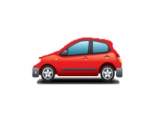
With Increasing Autonomy, Insurance Liability Likely to Shift to Software Algorithms
Present-day Motor Insurance Model in driver centric
Driver centric evaluation
Future Motor Insurance Model
1. Brand centric evaluation
2. Product centric evaluation
3. System centric evaluation
Crash Prevention, Crash Worthiness, Algorithm.
Pods, personal vehicles, group rapid transit vehicles
Increased Comfort, Option To Take Manual Control.
Or
Or
>80%
<20%
Manufacturers
Product Liability
Users share
of liability
  * Vehicle owner pays premium to cover some excesses such as stray incidents like theft, fire and vandalism
Source: Frost & Sullivan
Notes:
Currently insurance business revolves around the complex risk assessment process that is bound around the driver of the vehicle. Almost all major factors that define the boundaries of insurance premium are pertaining to the driver. But in the future there could we various possibilities of how the insurance could spin out to be.
In a brand centric evaluation, the OEMs capability to provide automation and its rating could define the premium. This means to say that a volume OEM with comparatively more rudimentary form of automated driving could attract more premium that a benchmark automated driving by a premium OEM.
Various types of automated vehicles could also attract different premiums based on their usability and purpose. Moreover, the complexity of the system and the use cases it hands over control to the driver may also be a possible parameter for defining premium. All of these scenarios exclusively or in collaboration would result in a significant shift in ownership of lability from the driver to the OEM.
Factors Effecting Future of Insurance:
Regulation: In NA, insurance is state-regulated. Each jurisdiction has its own set of rules and regulations for auto insurance (and so far for self-driving cars). Basically, there are two kinds of liability systems. In some states liability is based on the no-fault concept, where insurers pay the injured party regardless of fault, and in others it is based on the tort system. But there are many important differences among the states in the regulations that now exist within each category, see report on No-Fault Auto Insurance. Will the auto insurance system change to be more uniform with the arrival of self-driving vehicles and will the federal government play a larger role? If car manufacturers are required to accept more responsibility for damage and injuries, they might push for a greater role for the federal government to eliminate some of the cost of complying with the rules of 51 jurisdictions.
Underwriting: Initially, many of the traditional underwriting criteria, such as the number and kind of accidents an applicant has had, the miles he or she expects to drive and where the car is garaged, will still apply, but the make, model and style of car may assume a greater importance. The implications of where a car is garaged and driven might be different if there are areas set aside, such as dedicated lanes, for automated driving.
During the transition to wholly autonomous driving, insurers may try to rely more on telematics devices, known as “black boxes,” that monitor driver activity. Some drivers may object to them based on concerns about privacy. Usage-based insurance policies, which depend on data about the driver’s behavior submitted by an electronic device in the driver’s car, have attracted a smaller than expected percentage of the driving population, possibly because people do not want to be monitored. According to the National Association of Insurance Commissioners, use of telematics is forecast to grow to up to 20 percent within the next five years.
Liability: As cars are become increasingly automated the onus might be on the manufacturer to prove it was not responsible for what happened in the event of a crash. The liability issue may evolve so that lawsuit concerns do not drive manufacturers and their suppliers out of business
RAND has suggested some kind of no-fault auto insurance system. Others foresee something akin to the National Childhood Vaccine Injury Act, a no-fault compensation program for vaccine recipients who suffer a serious adverse reaction when vaccinated. The legislation was passed in 1986 in response to the threat that life-saving vaccines might become scarce or even unavailable if manufacturers, overwhelmed by claims of injury, scaled back or terminated production.
Repair Costs: While the number of accidents is expected to drop significantly as more crash avoidance features are incorporated into vehicles, the cost of replacing damaged parts is likely to increase because of the complexity of the components. It is not yet clear whether the reduction in the frequency of crashes will lead to a reduction in the cost of crashes overall.

Slide 30
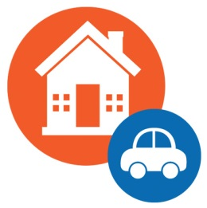

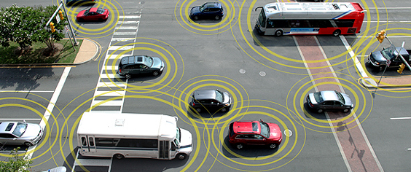
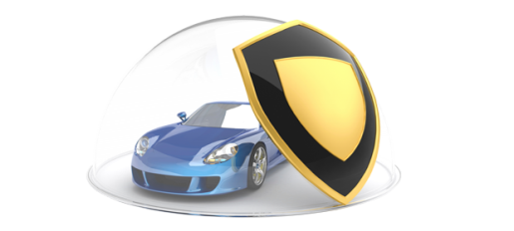
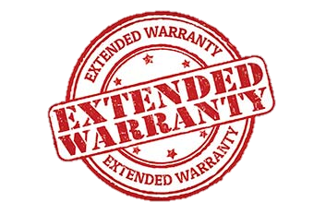
Future to evolve to bundling of motor insurance with other services:
Four possible scenarios of Motor insurance
1
2
Motor insurance bundled along with property insurance
3
4
Insurance risk split between manufacturer and other stakeholders
Motor insurance offered by vehicle manufacturers
Motor insurance built into extended warranty
Fully-automated Driving Traffic
Traditional Motor Insurance Model
Notes:
As premiums plummet, due to reduced crash risk, motor insurance may be bundled with other insurance packages or allowing vehicle manufacturers to pack motor insurance into other packages such as warranty
Future scenarios
Although current technology and legislation are still very much works in progress, there are strong forces that do stand to reshape the sector, including shifts to new types of coverage, alternative distribution channels, and redefined customer segments. We envision three highly possible evolutionary changes to the personal auto insurance industry’s products, distribution, and customers, as well as one more truly transformative change that, if it occurs, would significantly affect the shape and size of the industry as we know it.
Risk shifting – Advanced automotive technologies that reduce collisions, such as location awareness and automatic braking, will increasingly shift the risk of driver error to the risk of mechanical malfunction. This would shift driver liability to manufacturers and result in a new form of auto insurance that could be packaged with cars that rely on these technologies. In turn, this would shift the key buyer from the end-consumer to the manufacturer, and fundamentally change the entire value chain, from product definition to pricing, marketing, distribution, underwriting, service, and claims. If carriers decide to market this coverage to consumers, then they would do so either at the point of sale, or perhaps try to increase market share by co-marketing with the manufacturer and/or dealer.
Risk sharing – Smartphone apps and social networking have already started to play a role in collision reduction. In addition, the dramatic rise in social networking has enabled individuals to develop new affinities wherein people with similar attitudes, interests, and behaviors can pool resources to share risk and lower overall costs. For example, there are new carriers that combine social networking with insurance by connecting customers to form insurance networks that promise significantly lower premiums. These carriers claim that their models allow insurers to access new customers virally, decrease process costs, and reduce claim ratios. While, on the one hand, this represents the potential for lower rates for more groups, on the other hand, it also could make insurance more affordable for some and therefore lead to premium growth.
Risk slicing – Urban living and the increasing availability of automotive time-sharing suggests a future in which premiums move from 24-hour asset coverage to a pay-per-use model. Over 80 percent of the US and over 50 percent of the global population is considered urban; understandably, car sharing is rapidly growing. According to a Frost & Sullivan research estimate that Forbes reported in March 2012, the global car sharing market could exceed $10 billion by 2020, and the North American car sharing market alone could surpass 4.4 million members and $3 billion by 2016. As a result, an increasing number of low-frequency drivers is likely to mean at least some reduction in individual premiums. However, this scenario does not necessarily represent only lost premiums. Most of the people do not choose to own cars will need to rent them at least occasionally; accordingly, car sharing can expand the market for alternative buyers of insurance.
Risk reduction – Unlike the above scenarios that represent significant change but not necessarily extreme disruption to the insurance industry, driverless cars equipped with the latest awareness technologies could completely change the industry as we know it. Google, Inc.’s auto research investments are hastening the eventual, widespread availability of driverless cars. Google’s driverless, laser-equipped vehicles have logged over 300,000 miles without an accident; moreover, the company has begun investing in the research and development that initially sets and then drives down the costs of new technologies. Driverless cars are now legal on California roadways, and Google’s US spending on advocacy of driverless vehicles exceeded $9 million in just the first half of 2012.5 Google estimates that the technology can reduce traffic accidents, the number of cars, and wasted commute time and energy by 90 percent, thereby resulting in savings of $2 trillion per year for the US economy.6 Moreover, in March 2012, J.D. Power and Associates found 37 percent of US consumers were interested in autonomous driving technology. More impressively, the first phase of the NHTSA’s Safety Pilot revealed that 9 out of 10 drivers who experienced V2V technology “have a highly favorable opinion of its safety benefits and would [value] V2V safety features on their personal vehicle.”

Slide 31
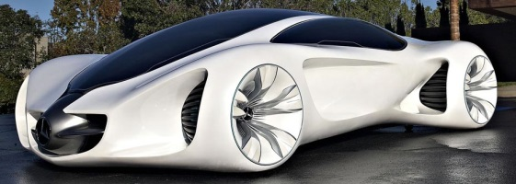
The Car of the Future: Self Learning Cars
Use of automated driving and connectivity to create a predictive environment that is safe and contextually relevant
Naturalistic Automated Driving
NFC Vehicle Personali-zation
Predictive
Calling
Predictive
Destination
Predictive
Connected
Services
Prognostic
Alerts
Automatic
Parking
Safety Mobility Fuel Economy
Self Learning Car
Source: Frost & Sullivan
Notes:
Car of the future enabled by the above discussed areas.
Naturalistic driving is a form of L3 automation and above where the vehicle learns to mimic the driver in terms of his/her driving style. The concept is artificial intelligence enabled through a number of means – machine learning through the camera sensors (Daimler calls this scene labelling) and analytics of driving data. This is what HERE wants to enable through its HD maps and cloud/analytics capabilities. This is what many OEMs like BMW, Acura are researching that will make automation a lot more personalized and not pureplay robotic.
Predictive connected services is where the connectivity and custom algorithms can understand driver habits and makes the entire experience contextual. The similar comparison is Google Now which is a predictive feature on Android phoners.

Slide 32
  Business Implication of Future Mobility Models for Key Stakeholders
Although each stakeholder can posses a strong core competence, expanding their radius of power to exercise more control on at least one other stakeholder can increase the probability of success.
Uber
Lyft
Google
With high volume of business and relatively lower investment which helps connect demand and supply, mobility integrator is likely to reap higher profits.
High Profitability
Asset Light Mobility Integrator
Eddie Stobart
Vos Logistics
Simon Loos
Asset Oriented Fleet Operator
Owning and maintaining a fleet of vehicles requires moderate levels of investments affects profitability
Ford
Daimler
Honda
Vehicle Manufacturer
Huge investments on infrastructure and machinery to manufacture different types of vehicles combined with decline in sales is likely to have adverse impact on profit margins
Low Profitability
Low Volume Business
High Volume Business
Data Flow
Material Flow
Source: Frost & Sullivan
Notes:
With relatively fewer entry barriers the Mobility integrator market is also likely to be commoditized
Finding the right vehicle mix across occupancy ranges is a challenging task given the uncertainty of commuting needs
OEMS that lack fleet management or mobility integration capability are likely to struggle in monetizing their business model.

Slide 33
Conclusions

Slide 34
Intelligent Mobility—OEMs’ Competencies Compared with Disruptors
Coexistence of disrupter-led mobility models alongside traditional OEM-led business models would increase competitiveness thereby resulting in the evolution of new market differentiators among rivalling brands.
Disruptor
Low
Medium
High
High
Medium
Low
Mobility integration capability leveraging connectivity and data
Data acquisition and processing capability held by disrupters gives them added advantage over traditional OEMs
Disrupters are likely to achieve comparable customer acceptance due to product success and the perceived quality
User group acceptance potential
Ability to create / modify architecture for purpose-built vehicles
OEMs with extensive experience in manufacturing different types of automobiles are likely to have an edge over the disruptors
OEM
Source: Frost & Sullivan
Notes:
User group acceptance, data-processing capability,
Ability to modify architecture for purpose-built vehicles

Slide 35




Mobility Ecosystem Will Remain Hybrid Value Chain for Next 5 Years
Coexisting with the traditional ecosystem, a smartphone-like ecosystem may evolve in the automotive industry, which is strongly based on a user-interface oriented, service-driven business model.
2015
2015: Stronghold in user interface domain
2025: Spearhead the service-driven industry
2025
Mobility Integrators
Connectivity Providers
2015: Pure-play digital influencers
2025: Connected mobility enablers
Suppliers
2015: Expanding product portfolio
2025: Digital innovation blended with electronic controls
OEMs
2015: Traditional power houses
.
2025: Hardware providers in a service industry
Key segments influencing the market
High
Source: Frost & Sullivan
Low

Slide 36




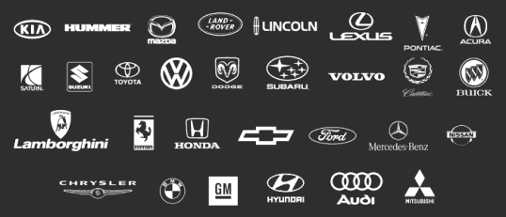

Tech Invasion – a Key Enabler and Motivator for Conventional OEMs
Tech companies innovate to offer a products/services that meets the unknown needs/demands of consumers, creating white space opportunities between the automotive and consumer electronics worlds
Possibly use open patents available as a platform to reduce cost and time involved to re-invent the wheel.
Unknown
Needs/Demands
Known
Conventional automotive OEMs
Incremental
Radical
Innovation
Source: Frost & Sullivan
Notes:
Tech companies are developing fully autonomous capability, while OEMs adopt an incremental approach in line with potential commercialization.
Farraday Futures launch. 20 new R&D labs in the Silicon Valley back by Chinese investors

Slide 37

Thank You
Niranjan Thiyagarajan
Senior Consultant
Frost & Sullivan
+44. 207. 915. 7818
Niranjan.thiyagarajan@frost.com

